Slide 1
Week 4 Review and Discussion

Slide 2
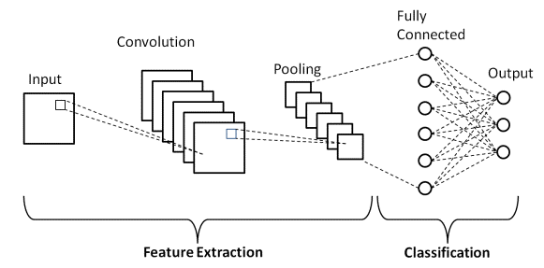
Convolutional Neural Network (CNN)

Slide 3
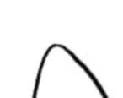
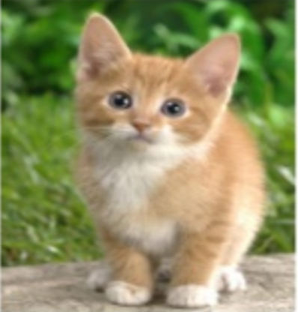
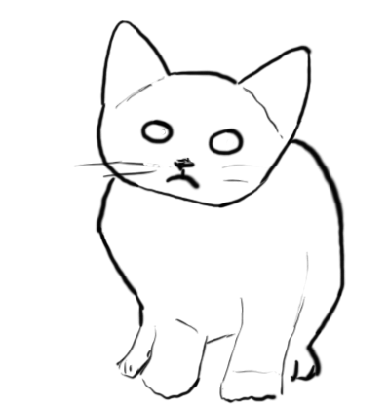
Filtering

Slide 4
CNN – Convolution
1 | -1 | -1
-1 | 1 | -1
-1 | -1 | 1
Filter 1
1 | 0 | 0 | 0 | 0 | 1
0 | 1 | 0 | 0 | 1 | 0
0 | 0 | 1 | 1 | 0 | 0
1 | 0 | 0 | 0 | 1 | 0
0 | 1 | 0 | 0 | 1 | 0
0 | 0 | 1 | 0 | 1 | 0
3
-1
-3
-1
-3
1
0
-3
-3
-3
0
1
3
-2
-2
-1
6 x 6 image
Credit: Hung-yi Lee

Slide 5
CNN – Max Pooling
3
-1
-3
-1
-3
1
0
-3
-3
-3
0
1
3
-2
-2
-1

